Slide 1
VIO in vSLAM using OpenVINS
Abdul Al-Badawi, Yuzhi Gu, Haiduo Liu, Abdusattor Sattarov and Luoyan Zhang

Slide 2
Project Description
This project demonstrates Visual Inertial Odometry (VIO) techniques for state estimation that aids robot navigation using visual tracking support from camera inputs and an inertial measurement unit (IMU), in addition, to performing Visual Simultaneous Localization and Mapping (vSLAM) with OpenVINS as the main algorithm.

Slide 3
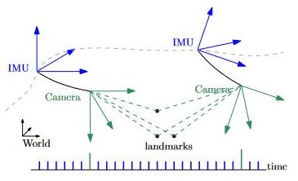
Visual-Inertial Odometry (VIO)
It is the process of estimating position and orientation (pose) as well as velocity of an agent with the aid of one or more camera and one or more IMU. It estimates the state of the sensor suite using the camera and IMU measurements and incorporates the use of vSLAM (localization and mapping).
Figure: illustration of VIO configuration

Slide 4
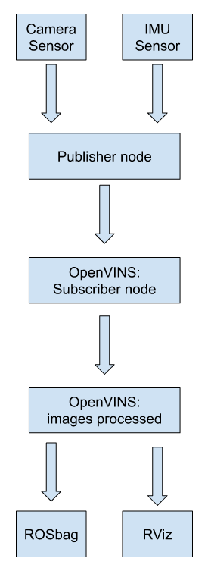
OpenVINS
OpenVINS fuses inertial information with sparse visual feature tracks through the use of a Multi-State Constraint Kalman Filter (MSCKF), an Extended Kalman Filter, sliding window formulation allowing 3D features to update the state estimate without directly estimating the feature states in the filter. After launching the subscriber node and playing the bag file, the system publishes features and a state estimation.

Slide 5
Visual-Inertial Simulator
Inertial Measurements
VISUAL-INERTIAL SIMULATOR
(B-spline)
Pose Trajectory
Pose Information
Notes:
Here is an important simulator that used in open vins. The only needed input into the simulator is a pose trajectory which we uniformly sample to construct control points for visual-inertial simulator. This visual-inertial simulator is then used to both generate the inertial measurements while also providing the pose information needed to generate visual-bearing measurements.

Slide 6
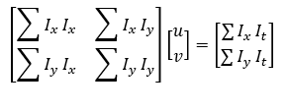
Tracking (TrackKLT)
I(x,y,t) is the illuminance at pixel (x,y) at time t.
Brief process of tracking.
First Image Frame
Extract and save Feature Points
Track
Delete Loss Feature Points
Replace
Second Image Frame
Extract
Feature Points
Notes:
Open vins provides three different trackers. Taking Lucas-Canada Tracker as an example. We can use this formula to calculate u and v, u means the velocity in x direction v means the velocity in y direction.
I(x,y,t) is the illuminance at pixel (x,y) at time t. Ix and Iy are the gradients of illuminance in the x, y directions. And then I will talk about the brief process of tracking. The feature points extracted from second image frame will be used to track the feature point from the first image. Then the loss feature points will be deleted and we move on to next circle. In the next circle first image frame will be replaced by second image frame and second image frame will be replaced by the third one.

Slide 7
Multi-State Constraint Kalman Filter
When a static feature is viewed from several camera poses, it is possible to define geometric constraints involving all these poses, without including the 3D feature position in the filter state vector.
X_I0
X’_I0
IMU
State
For each IMU measurement received,
propagate the filter state and covariance
Propagation
P_I0
Propagation
P’_I0
Augmentation
Augment state and covariance matrix
Image processing module begins
X’_I0
X_C0
X_I1
X_C0
Image Registration
Measurement
P’_I0
P_IC
P’_I1
P_IC
Update
When the feature measurements are
available, perform EKF update
Update
P_IC𝑇
P_C0
X_IC𝑇
P_C1

Slide 8
Why do we use Multi-State Constraint Kalman Filter?
Advantages of using VIO over VO
As a combination of IMU and Vision data under the EKF frame, it can:
Adapt to more intense movement, while maintain functioning with texture loss for a certain period of time.
Be more robust.
Advantages of using MSCKF over Standard Kalman Filter
Compared with the optimization-based VIO algorithm (VINS, OKVIS), MSCKF:
Adopts a structureless approach.
Runs on embedded platforms with limited computing resources.
Provides faster output with same accuracy.
Notes:
MSCKF has been widely used in the fields of robots, drones and AR/VR. For example, Google Project Tango uses MSCKF for pose estimation.
MSCKF has the same accuracy but it is faster, therefore it is Suitable for running on embedded platforms with limited computing resources
Adopts a structureless approach where landmark positions are marginalized out of the state vector, therefore, a small number of landmarks are typically tracked to allow real-time operation

Slide 9
ImageProcessor Front End & MSCKF-VIO Back End
Tracking Info
& Features
Cam_0 Image
BatchIMUProcessing
StateAugmentation
AddFeatureObserve
RemoveLostFeature
PruneCamStateBuffer
OnlineReset
StereoCallback()
for camera tracking and processing
FeatureCallback()
➡
Cam_1 Image
IMUCallback()
for IMU data storage
IMUCallback()
Bias and Gravity
IMU Data
Odom
Feature_point_cloud
Sensor data
Front End
Back End

Slide 10
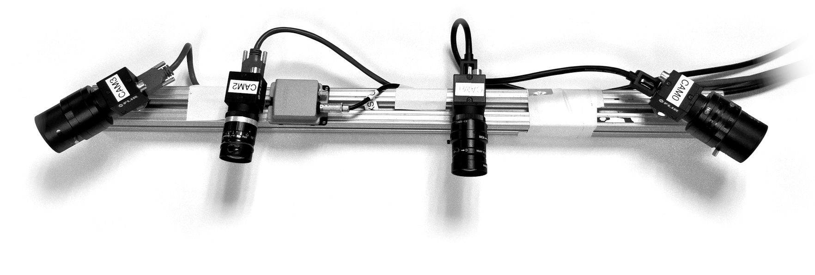
Sensor Setup & Datasets
Datasets:
The EuRoC MAV Dataset
TUM Visual-Inertial Dataset
RPNG OpenVINS Dataset
UZH-FPV Drone Racing Dataset
KAIST Urban Dataset
KAIST VIO Dataset
NUANCE Dataset
Figure: Sensor Setup Example [1]
Requirements:
Mono or Stereo Cameras
Inertial Measurement Unit (IMU)
Notes:
The sensor setup for OpenVINS usually requires a camera and an IMU. The main reason for using both of them is because of the complementary nature of the two different sensing modalities. The camera provides high density external measurements of the environment, while the IMU measures internal ego-motion of the sensor platform. The IMU is crucial in providing robustness to the estimator while also providing system scale in the case of a monocular camera. In this project, we could use datasets from 6 different organizations as well as the data from our NUANCE car.

Slide 11
Progress
Example of RViz running OpenVINS on a demo dataset from EuRoC.
Sensor Setup:
Monochrome stereo images at 20Hz
MEMS ADIS16448 IMU at 200Hz
Environment:
Ubuntu 20.04
ROS 1 Noetic
Notes:
As of today, our team has successfully downloaded the code as well as one of the demo datasets. This gif y’all are seeing is the actual recording from our local environments.
The calibration parameters were given with the dataset from EuRoC.

Slide 12
Challenges and Next Steps
Challenges Faced
Ubuntu crashed multiple times when building the project.
catkin_make failed to execute numerous times, it eventually took over four hours to execute on one occasion.
NUANCE dataset is too large and downloading time took longer than anticipated.
The calibration parameters for NUANCE could not be easily imported to OpenVINS.
Next Steps
Configure the calibration parameters for NUANCE.
Run OpenVINS.
Perform data analysis on the estimated trajectory and the ground truth.
Final report.
Notes:
Satt
Software:
OpenVINs
Issues with RAM; Needed to allocate more RAM to Ubuntu
Requires strong hardware
Data and memory storage:
Tutorial sample data is only 2.5GB

Slide 13
References
[1] P. Geneva, K. Eckenhoff, W. Lee, Y. Yang, and G. Huang, “OpenVINS: A research platform for visual-inertial estimation,” in Proc. of the IEEE International Conference on Robotics and Automation, Paris, France, 2020. [Online]. Available: https://github.com/rpng/open_vins.
[2] A. I. Mourikis and S. I. Roumeliotis, "A Multi-State Constraint Kalman Filter for Vision-aided Inertial Navigation," Proceedings 2007 IEEE International Conference on Robotics and Automation, 2007, pp. 3565-3572, doi: 10.1109/ROBOT.2007.364024.
[3] OpenVINS. docs.openvins.com.
[4] “Visual and Inertial Odometry.” UZH, Universität Zürich, 7 June 2019, https://www.ifi.uzh.ch/en/rpg/research/research_vo.html#top.

Slide 14
Thank You!
Any Questions?

